Slide 1

Fruit Detection using Machine Learning.
Team Members –
Ekta Chaugule
Bhairavi Shinde
Vedant Salunkhe
Saad Mirza
Examined by- Prof. Shalaka Deore

Slide 2
Introduction
We will build a simple form of Fruit Recognition System. Although the example we’ll use is very simple, it reflects many of the same key machine learning concepts that go into building real-world commercial systems.
The Machine will be able to recognize the fruits as per the data provided, accurately.
We have imported the required libraries and the data of one fruit is being subdivided for better accuracy.

Slide 3
Literature Survey
We have done some study in these papers before implementing our actual project.
These papers helped us a lot for getting into our final idea.
https://ieeexplore.ieee.org/document/9690537
https://ieeexplore.ieee.org/document/7915033

Slide 4
Motivation
In the field of agriculture and food processing, quality evaluation is a significant parameter to increase benefits and accommodations for individual life. The presence of diseases and pesticides is additionally the major factor that emerges the need for quality evaluation. Although it can be done manually, some inconsistencies and high costs.
This motivates us to choose to built a machine learing model which will solve the above problem.

Slide 5
Objective
To study about the KNN algorithm and about machine learning.
To study about the given fruit and vegetable using the app.
To help people distinguish about similar shaped and similar colored fruits using the application.
To study the biological and scientific data of the given fruit or vegetable.
This program is for helping people recognize any foreign fruit or vegetable which are unknown to them.

Slide 6
Fruit Detection using Machine Learning
Problem Statement
Distinguish the type of fruit using the data provided by the user.
Differentiate between different subtypes using fruits.
2

Slide 7
METHODOLOGY
K-Nearest Neighbor is one of the simplest Machine Learning algorithms based on Supervised Learning technique. K-NN algorithm assumes the similarity between the new case/data and available cases and put the new case into the category that is most similar to the available categories.
K-NN algorithm stores all the available data and classifies a new data point based on the similarity. This means when new data appears then it can be easily classified into a well suite category by using K- NN algorithm.
Example: Suppose, we have an image of a creature that looks similar to cat and dog, but we want to know either it is a cat or dog. So for this identification, we can use the KNN algorithm, as it works on a similarity measure. Our KNN model will find the similar features of the new data set to the cats and dogs images and based on the most similar features it will put it in either cat or dog category.

Slide 8
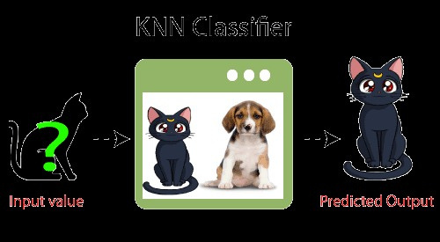

Slide 9

Flowchart..

Slide 10
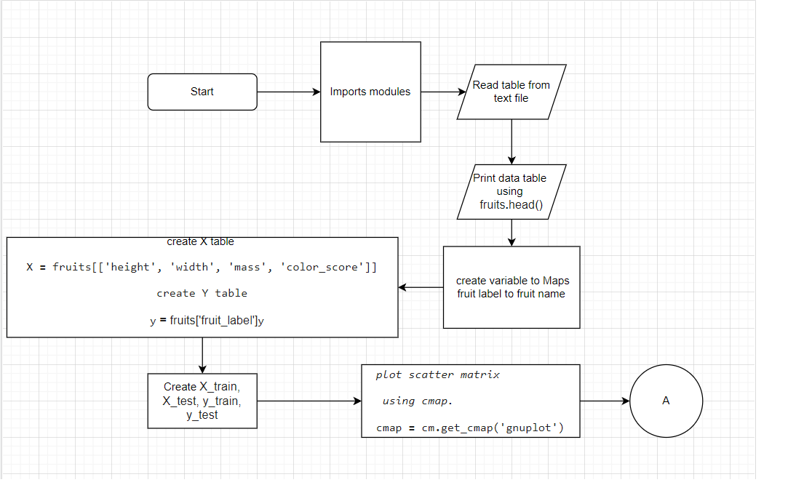

Slide 11
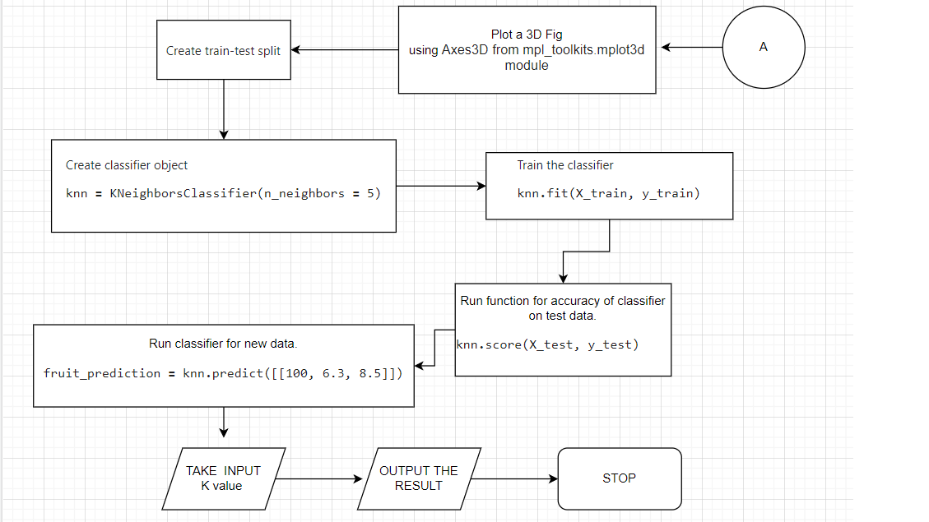

Slide 12
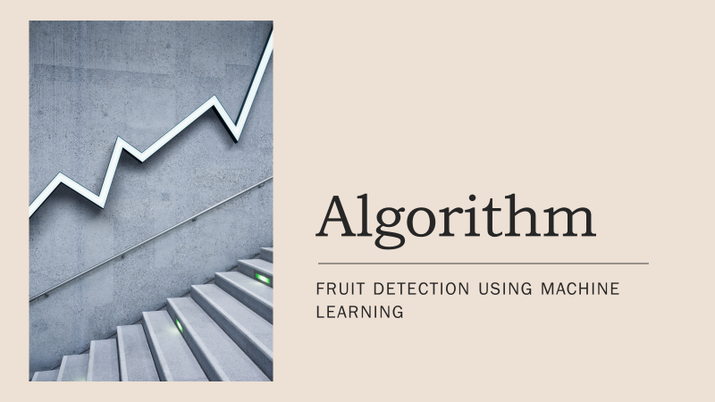

Slide 13
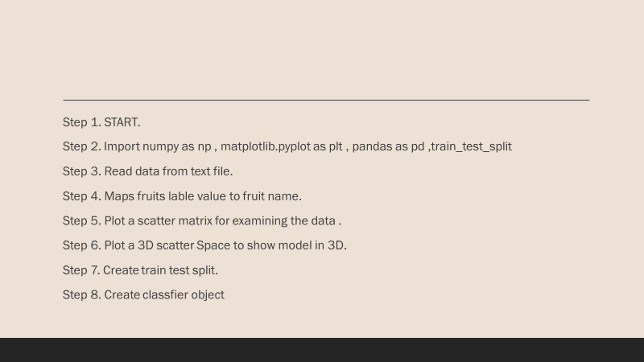

Slide 14
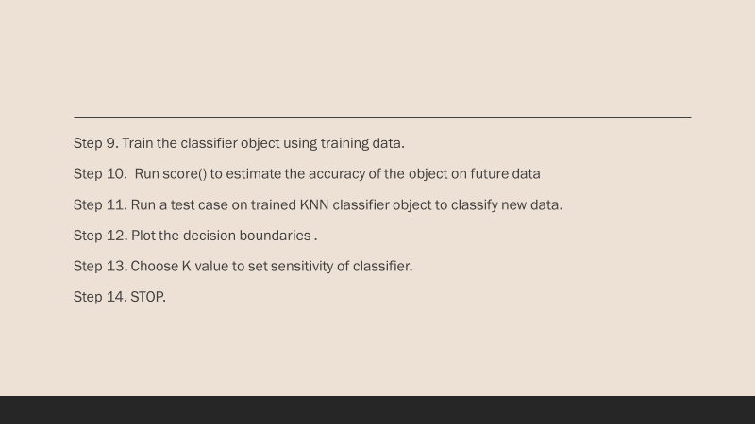

Slide 15
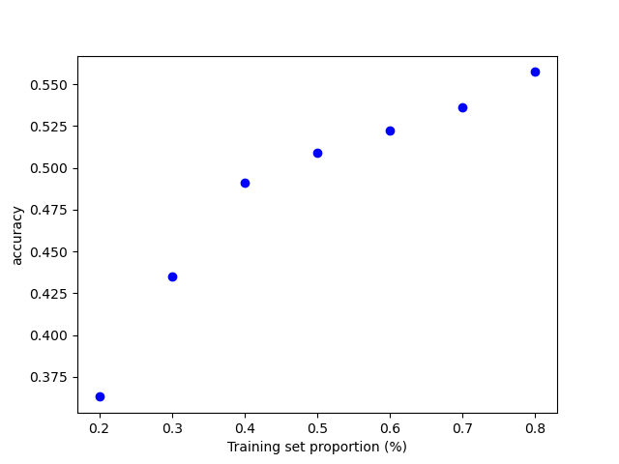
Training Set Proportion(%) | Accuracy
0.2 | 0.200
0.3 | 0.430
0.4 | 0.490
0.5 | 0.510
0.6 | 0.520
0.7 | 0.535
0.8 | 0.550

Slide 16
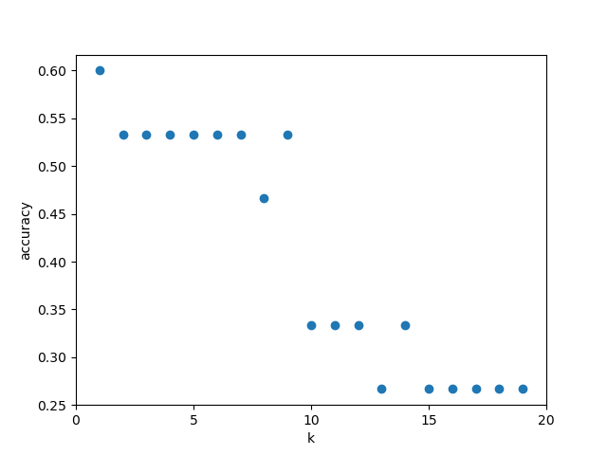
0 | 0
5 | 0.53
10 | 0.34
15 | 0.256
20 | 0
k
Accuracy

Slide 17
Software Requirements
Windows 10 or later OR Ubuntu 20.04 or later
Python 3.8 or later

Slide 18
Hardware Requirements
Core i3 or better.
Minimum 4 gb Ram
Free space of 10 gb or more
Keyboard, Mouse, Monitor

Slide 19
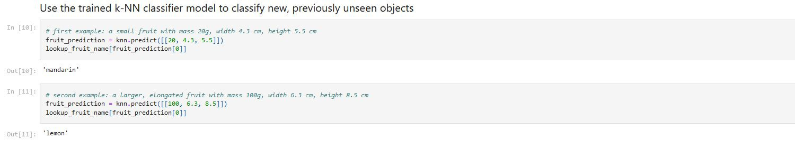
Results

Slide 20
Conclusion
This program is build on the KNN algorithm (K- Nearest Neighbor ) which helps in the detection of the fruit or vegetable by scanning the image of the fruit. This program is mainly built to differentiate between different kind of the fruit and also to retrieve information of the given fruit including the name and biological facts of the fruit.

Slide 21
Future Scope
Now you might think fruit prediction is a silly and impractical scenario. And given the limited nature of this dataset, it is a bit of a toy example. But food companies do now rely on machine learning systems that aren’t all that different in concept from the ones we’re about to build, so they can do Automated Quality Control.
For example, real systems used by fruit shipping companies that screen for rotten oranges during processing. Now the features they use in building these systems are a little more sophisticated than the ones we did in this example.
Quality control systems for rotten orange detection use ultraviolet light that can detect interior decay, which is often less visible than just by looking on the surface.
From above points, we can conclude that there is future scope for this.

Slide 22
REFERENCES
https://www.c-sharpcorner.com/article/a-simple-classification-techniques-on-fruit-dataset/
https://medium.com/swlh/fruit-classification-with-k-nearest-neighbors-191cf0497036
https://ieeexplore.ieee.org/document/9065747
https://ieeexplore.ieee.org/document/9690537
https://ieeexplore.ieee.org/document/7915033

Slide 23
Thank
you!

